Slide 1
Module II-User defined Functions
User defined Functions – Declarations –Definition- Call by value and call by reference- Types of functions- Recursive functions-Storage Classes-Scope , Visibility and Life time of variables.

Slide 2
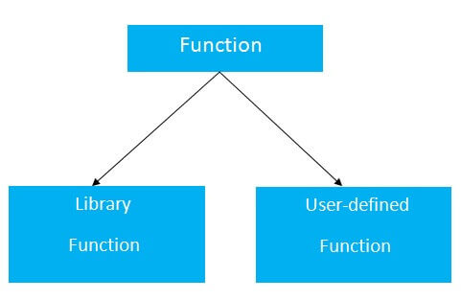
Function
A function is a block of code that can be used to perform a specific action.

Slide 3
Function
Library functions are those functions which are already defined in C library, example printf(), scanf(), strcat() etc. You just need to include appropriate header files to use these functions. These are already declared and defined in C libraries.
A User-defined functions on the other hand, are those functions which are defined by the user at the time of writing program. These functions are made for code reusability and for saving time and space.

Slide 4
Library function- example:
#include <stdio.h>
// header file is included in which printf() function exists
int main() // main function
{
printf("Hello everyone! I am a bot.");
// printf() function is used for printing the sentence
}

Slide 5
USER DEFINED FUNCTIONS

Slide 6
Benefits of Using Functions (User defined)
It provides modularity to your program's structure.
It makes your code reusable.
You just have to call the function by its name to use it, wherever required.
In case of large programs with thousands of code lines, debugging and editing becomes easier if you use functions.
It makes the program more readable and easy to understand.

Slide 7
Function
C allows programmers to write their own functions, also known as user-defined functions.
A user-defined function has three main components
Function declarations
Function definition
Function call
Functions can be called by call by value or call by reference.
Functions need to be written once and can be called as many times as required inside the program, which increases reusability in code and makes code more readable and easy to test, debug, and maintain the code.

Slide 8
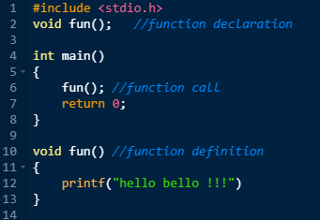
User Defined function fun()

Slide 9
Program to multiply 2 numbers using function
#include<stdio.h>
int multiply(int a, int b); // function declaration
int main()
{
int i, j, result;
printf("Enter 2 numbers to multiply...");
scanf("%d%d", &i, &j);
result = multiply(i, j); // function call
printf("The result of multiplication is: %d", result);
return 0;
}
int multiply(int a, int b) // function defintion
{
return (a*b);
}

Slide 10
Function Declaration
A function declaration is also known as the function prototype and it consists of 4 parts given below.
Return type
Name of the function
List of parameters
Terminating semicolon
int sum(int a,int b);

Slide 11
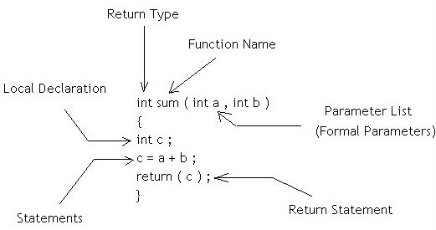
Function definition

Slide 12
Function Parameters
Formal Parameter
Parameter Written in Function Definition is Called “Formal Parameter”. Formal parameters are always variables, while actual parameters do not have to be variables.
Actual Parameter
Parameter Written in Function Call is Called “Actual Parameter”.
One can use numbers, expressions, or even function calls as actual parameters

Slide 13
Function Return Type
The function return type specifies the data type that the function returns to the calling program.
The return type can be any of C′s data types: char, int , long , float , or double .
One can also define a function that doesn′t return a value by using a return type of void.

Slide 14
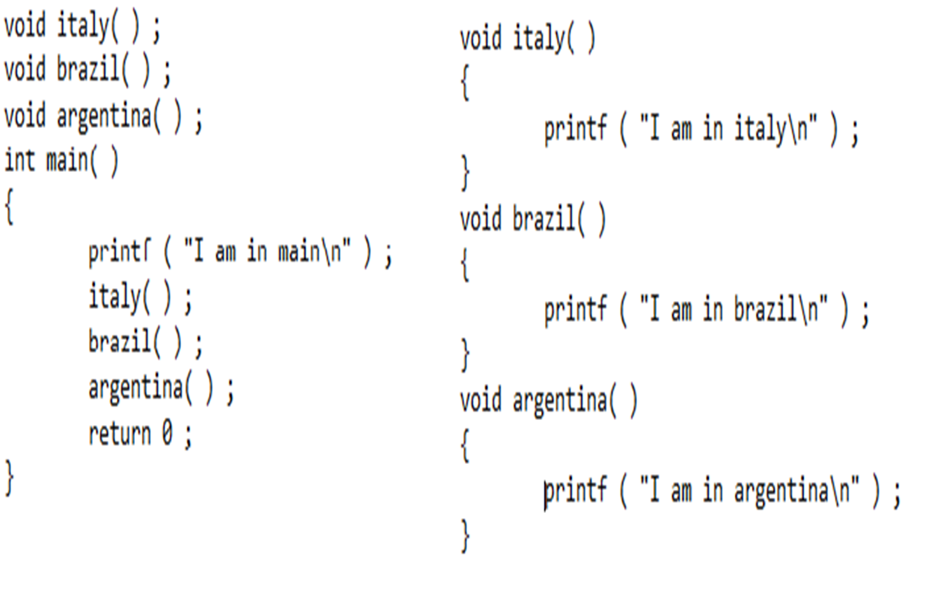
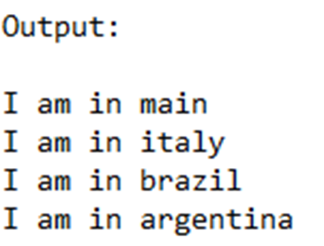

Slide 15
//A function that return the maximum between two numbers
int max(int num1, int num2)
{ /* local variable declaration */
int result;
if (num1>num2)
result=num1;
else
result=num2;
return result;
}
void main()
{
int r;
r=max( 10,15);
print(“Result = %d “ , r);
}

Slide 16

A C program is a collection of one or more functions.
If a C program contains only one function, it must be main( ).
If a C program contains more than one function, then one (and only one) of these functions must be main( ), because program execution always begins with main( ).

Slide 17
There is no limit on the number of functions that might be present in a C program.
Each function in a program is called in the sequence specified by the function calls in main( ).
After each function has done its thing, control returns to main( ).When main( ) runs out of statements and function calls, the program ends.

Slide 18
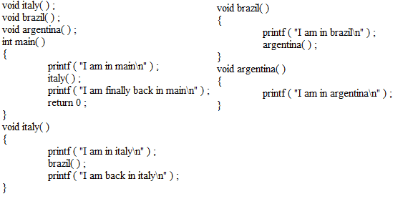
Program showcasing the Control Flow

Slide 19
Point to be noted
A function gets called when the function name is followed by a semicolon ( ; ).
For example,
argentina( ) ;

Slide 20
Point to be noted
A function is defined when function name is followed by a pair of braces ( { } ) in which one or more statements may be present.
For example,
void argentina( )
{
statement 1 ;
statement 2 ;
statement 3 ;
}

Slide 21
Point to be noted
Any function can be called from any other function. Even main( ) can be called from other functions.
A function can be called any number of times.
The order in which the functions are defined in a program and the order in which they get called need not necessarily be same.

Slide 22
Point to be noted
A function can call itself. Such a process is called ‘recursion’
A function can be called from another function, but a function cannot be defined in another function.

Slide 23
Why use Functions?
Writing functions avoids rewriting the same code over and over.
By using functions it becomes easier to write programs and keep track of what they are doing.
Note: Don’t try to cram the entire logic in one function. It is a very bad style of programming.

Slide 24
Types of User-defined Functions in C
Function with no arguments and no return value
Function with no arguments and a return value
Function with arguments and no return value
Function with arguments and with return value

Slide 25
Function with No Arguments and No Return Value
Functions that have no arguments and no return values. Such functions can either be used to display information or to perform any task on global variables.
Syntax:
// void return type with no arguments
void function_name()
{
// no return value
return;
}

Slide 26
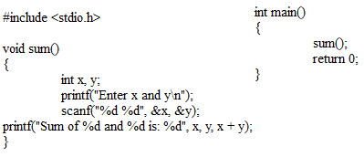
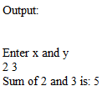

Slide 27
Function with No Arguments and With Return Value
Functions that have no arguments but have some return values. Such functions are used to perform specific operations and return their value.
Syntax:
return_type function_name()
{
// program
return value;
}

Slide 28
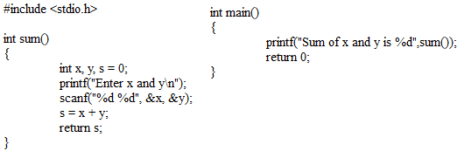


Slide 29
Function With Arguments and No Return Value
Functions that have arguments but no return values. Such functions are used to display or perform some operations on given arguments.
Syntax:
void function_name(type1 argument1, type2 argument2,...typeN argumentN)
{
// Program
return;
}

Slide 30
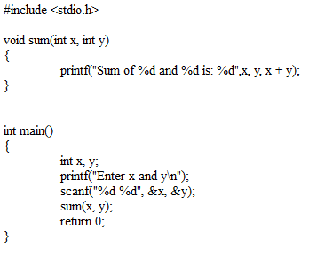


Slide 31
Function With Arguments and With Return Value
Functions that have arguments and some return value. These functions are used to perform specific operations on the given arguments and return their values to the user.
Syntax:
return_type function_name(type1 argument1, type2 argument2,...typeN argumentN)
{
// program
return value;
}

Slide 32
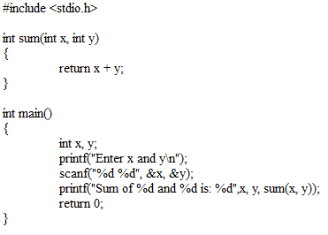


Slide 33
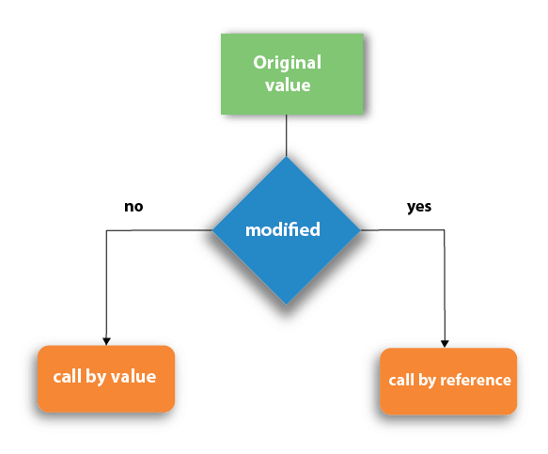
Call by value and Call by reference in C

Slide 34
Call by value
In call by value method, the value of the actual parameters is copied into the formal parameters.
In other words, we can say that the value of the variable is used in the function call in the call by value method.
In call by value method, we can not modify the value of the actual parameter by the formal parameter.
In call by value, different memory is allocated for actual and formal parameters since the value of the actual parameter is copied into the formal parameter.
The actual parameter is the argument that is used in the function call whereas the formal parameter is the argument that is used in the function definition.

Slide 35
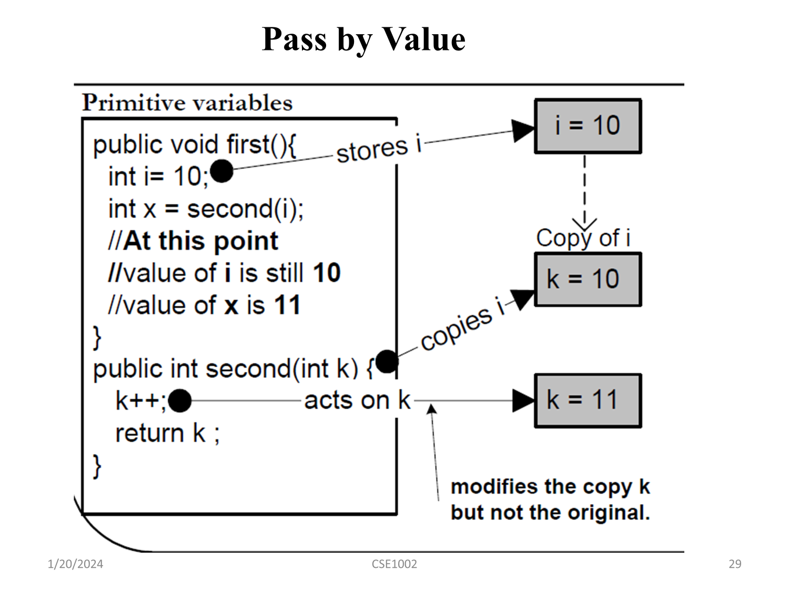

Slide 36
Call by value
#include<stdio.h>
void change(int num) {
printf("Before adding value inside function num=%d \n",num);
num=num+100;
printf("After adding value inside function num=%d \n", num);
}
int main() {
int x=100;
printf("Before function call x=%d \n", x);
change(x);//passing value in function
printf("After function call x=%d \n", x);
return 0;
}
Output
Before function call x=100
Before adding value inside function num=100
After adding value inside function num=200
After function call x=100

Slide 37
#include <stdio.h>
void swap(int , int); //prototype of the function
int main()
{
int a = 10;
int b = 20;
printf("Before swapping the values in main a = %d, b = %d\n",a,b); // printing the value of a and b in main
swap(a,b);
printf("After swapping values in main a = %d, b = %d\n",a,b); // The value of actual parameters do not change by changing the formal parameters in call by value, a = 10, b = 20
}
void swap (int a, int b)
{
int temp;
temp = a;
a=b;
b=temp;
printf("After swapping values in function a = %d, b = %d\n",a,b); // Formal parameters, a = 20, b = 10
}
Output
Before swapping the values in main a = 10, b = 20
After swapping values in function a = 20, b = 10
After swapping values in main a = 10, b = 20

Slide 38
Call by reference
In call by reference, the address of the variable is passed into the function call as the actual parameter.
The value of the actual parameters can be modified by changing the formal parameters since the address of the actual parameters is passed.
In call by reference, the memory allocation is similar for both formal parameters and actual parameters. All the operations in the function are performed on the value stored at the address of the actual parameters, and the modified value gets stored at the same address.

Slide 39
#include <stdio.h>
void swap(int *, int *); //prototype of the function
int main()
{
int a = 10;
int b = 20;
printf("Before swapping the values in main a = %d, b = %d\n",a,b); // printing the value of a and b in main
swap(&a,&b);
printf("After swapping values in main a = %d, b = %d\n",a,b); // The values of actual parameters do change in call by reference, a = 10, b = 20
}
void swap (int *a, int *b)
{
int temp;
temp = *a;
*a=*b;
*b=temp;
printf("After swapping values in function a = %d, b = %d\n",*a,*b); // Formal parameters, a = 20, b = 10
}
Before swapping the values in main a = 10, b = 20
After swapping values in function a = 20, b = 10
After swapping values in main a = 20, b = 10

Slide 40
Recursive Function
Recursion is the technique of making a function call itself.
This technique provides a way to break complicated problems down into simple problems which are easier to solve.
In programming languages, if a program allows you to call a function inside the same function, then it is called a recursive call of the function.
The recursion continues until some condition is met to prevent it.
To prevent infinite recursion, if...else statement (or similar approach) can be used where one branch makes the recursive call, and other doesn't.

Slide 41
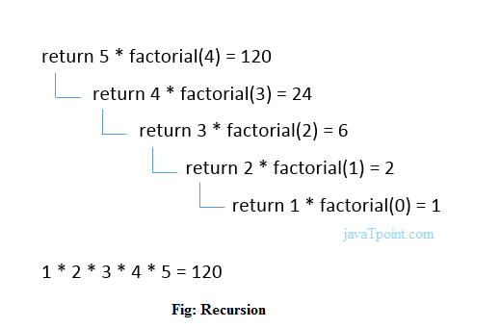
//Program for Factorial
#include <stdio.h>
int fact (int);
int main()
{
int n,f;
printf("Enter the number whose factorial you want to calculate?");
scanf("%d",&n);
f = fact(n);
printf("factorial = %d",f);
}
int fact(int n)
{
if (n==0) {
return 0; }
else if ( n == 1) {
return 1; }
else
{
return n*fact(n-1);
} }

Slide 42
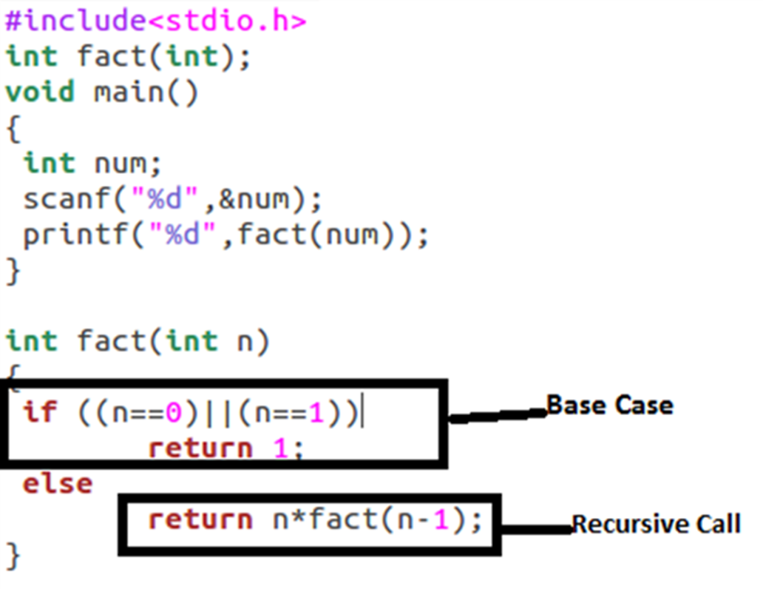
Factorial using Recursion

Slide 43
//Program for Fibonacci Series
#include <stdio.h>
int fibonacci(int i) {
if(i == 0) {
return 0;
}
if(i == 1) {
return 1;
}
return fibonacci(i-1) + fibonacci(i-2);
}
int main() {
int i;
for (i = 0; i < 10; i++) {
printf("%d\t\n", fibonacci(i));
}
return 0;
}
0
1
1
2
3
5
8
13
21
34

Slide 44
Tower of Hanoi
Tower of Hanoi is a mathematical puzzle where we have three rods (A, B, and C) and N disks. Initially, all the disks are stacked in decreasing value of diameter i.e., the smallest disk is placed on the top and they are on rod A. The objective of the puzzle is to move the entire stack to another rod (here considered C), obeying the following simple rules:
Only one disk can be moved at a time.
Each move consists of taking the upper disk from one of the stacks and placing it on top of another stack i.e. a disk can only be moved if it is the uppermost disk on a stack.
No disk may be placed on top of a smaller disk.

Slide 45

IF THERE ARE 2 DISKS AND 3 RODS A, B AND C
Input: 2
Output: Disk 1 moved from A to B
Disk 2 moved from A to C
Disk 1 moved from B to C

Slide 46
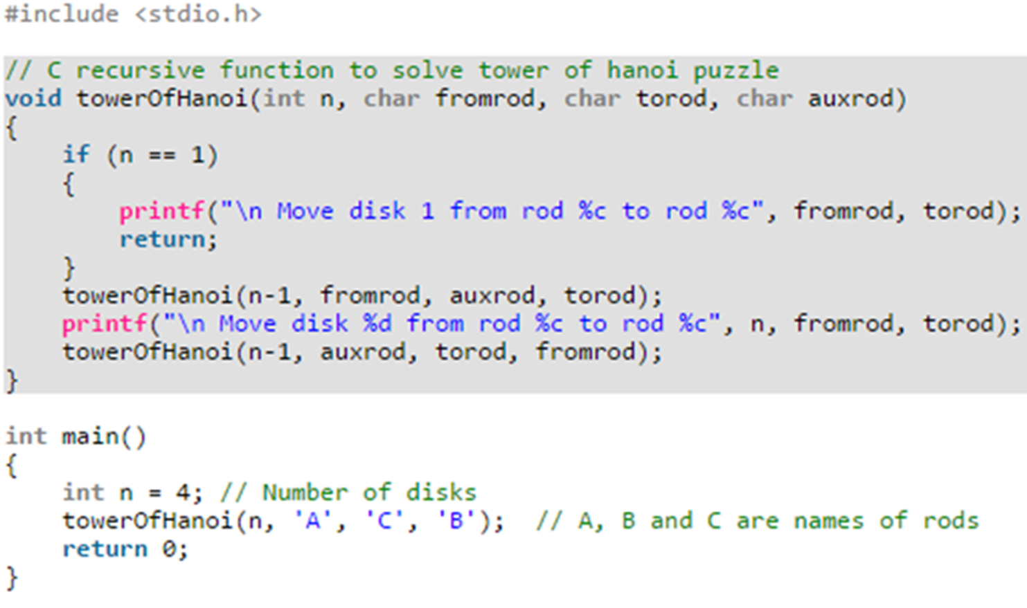
Towers of Hanoi

Slide 47
Adding Functions to the Library

Slide 48
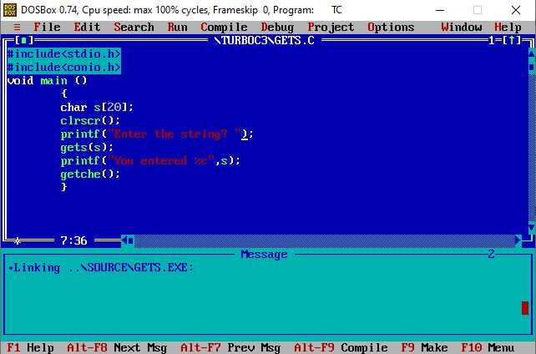

Slide 49
Add user-defined functions to the library
Different compilers provide different utilities to add/delete/modify functions in the standard library. For example, Turbo C/C++ compilers provide a utility called ‘tlib.exe’ (Turbo Librarian).

Slide 50
Steps to add a function factorial( ) to the library
Step 1 : Write the function definition of factorial( ) in some file, say ‘fact.c’.
int factorial ( int num )
{
int i, f = 1 ;
for ( i = 1 ; i <= num ; i++ )
f = f * i ;
return ( f ) ;
}

Slide 51
Steps to add a function factorial( ) to the library
Step 2 : Compile the ‘fact.c’ file using Alt F9. A new file called ‘fact.obj’ would get created containing the compiled code in machine language.
Step 3 : Add the function to the library by issuing the command
C:\>tlib math.lib + c:\fact.obj
Here, ‘math.lib’ is a library filename, + is a switch, which means we want to add new function to library and ‘c:\fact.obj’ is the path of the ‘.obj’ file.
If we wish we can delete the existing functions present in the library using the minus ( - ) switch.

Slide 52
Steps to add a function factorial( ) to the library
Step 4 : Declare the prototype of the factorial( ) function in the header file, say ‘fact.h’. This file should be included while calling the function.
Step 5 : To use the function present inside the library, create a program as shown below:
#include "c:\\fact.h"
main( )
{
int f ;
f = factorial ( 5 ) ;
printf ( "%d", f ) ;
}
Step 6 : Compile and execute the program using Ctrl F9.

Slide 53
creating our own library

Slide 54
Steps for creating our own library
Lets us create a library containing the functions factorial( ), prime( ) and fibonacci( )
For create this library following steps are carried out in specific to Turbo C/C++ compiler and would vary for other compilers.

Slide 55
Steps for creating our own library
Step 1 : Define the functions factorial( ), prime( ) and fibonacci( ) in a file, say ‘myfuncs.c’.
Do not define main( ) in this file.
Step 2 : Create a file ‘myfuncs.h’ and declare the prototypes of factorial( ), prime( ) and fibonacci( ) in it as shown below:
int factorial ( int ) ;
int prime ( int ) ;
void fibonacci ( int ) ;

Slide 56
Steps for creating our own library
Step 3 :
From the Options menu select the menu-item ‘Application’.
From the dialog that pops us select the option ‘Library’.
Select OK.
Step 4 :
Compile the program using Alt F9.
Finally :
Library file called ‘myfuncs.lib’ is created

Slide 57
Step to use the functions defined in this library

Slide 58
Step to use the functions defined in this library
Step 1 : Create a file, say ‘sample.c’ and type the following code in it.
#include "myfuncs.h"
main( )
{
int f, result ;
f = factorial ( 5 ) ;
result = prime ( 13 ) ;
fibonacci ( 6 ) ;
printf ( "\n%d %d", f, result ) ;
}

Slide 59
Step to use the functions defined in this library.
Note that the file ‘myfuncs.h’ should be in the same directory as the file ‘sample.c’.
If not, then while including ‘myfuncs.h’ mention the appropriate path.
Step 2 :
Go to the ‘Project’ menu and
select ‘Open Project…’ option.
On doing so a dialog would pop up.
Give the name of the project, say ‘sample.prj’ and
select OK.

Slide 60
Step to use the functions defined in this library.
Step 3 :
From the ‘Project’ menu
select ‘Add Item’.
On doing so a file dialog would appear.
Select the file ‘sample.c’ and
then select ‘Add’.
Also add the file ‘myfuncs.lib’ in the same manner.
Finally select ‘Done’.
Step 4 : Compile and execute the project using Ctrl F9.

